Slide 1


Final Project: Analyzing banking deposits and who our customers might be?
Andrew Klaassen, Jake Arluck, Jon Russ, Mariko Weaver, Quinn Knudsen
Group 2

Slide 2
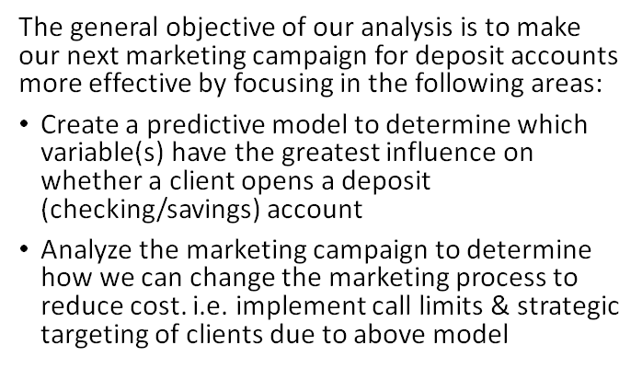

Group 2 Project: Bank Marketing for new deposit accounts
https://www.kaggle.com/janiobachmann/bank-marketing-dataset

Slide 3
Data Dictionary
Outcome variable (desired target):
Y – has the client subscribed a term deposit? (binary: 'yes', no')
Input variables:
# bank client data:
1 - age (numeric)
2 - job : type of job (categorical: 'admin.','blue-collar','entrepreneur','housemaid','management','retired','self-employed','services','student','technician','unemployed','unknown')
3 - marital : marital status (categorical: 'divorced','married','single','unknown'; note: 'divorced' means divorced or widowed)
4 - education (categorical: 'basic.4y','basic.6y','basic.9y','high.school','illiterate','professional.course','university.degree','unknown')
5 - default: has credit in default? (categorical: 'no','yes','unknown')
6 - housing: has housing loan? (categorical: 'no','yes','unknown')
7 - loan: has personal loan? (categorical: 'no','yes','unknown')
# related with the last contact of the current campaign:
8 - contact: contact communication type (categorical: 'cellular','telephone')
9 - month: last contact month of year (categorical: 'jan', 'feb', 'mar', ..., 'nov', 'dec')
10 - day_of_week: last contact day of the week (categorical: 'mon','tue','wed','thu','fri')
11 - duration: last contact duration, in seconds (numeric). Important note: this attribute highly affects the output target (e.g., if duration=0 then y='no'). Yet, the duration is not known before a call is performed. Also, after the end of the call y is obviously known. Thus, this input should only be included for benchmark purposes and should be discarded if the intention is to have a realistic predictive model.
# other attributes:
12 - campaign: number of contacts performed during this campaign and for this client (numeric, includes last contact)
13 - pdays: number of days that passed by after the client was last contacted from a previous campaign (numeric; 999 means client was not previously contacted)
14 - previous: number of contacts performed before this campaign and for this client (numeric)
15 - poutcome: outcome of the previous marketing campaign (categorical: 'failure','nonexistent','success')

Slide 4
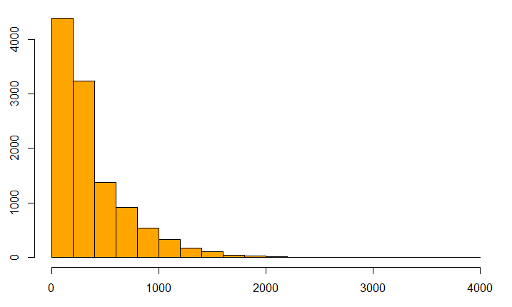
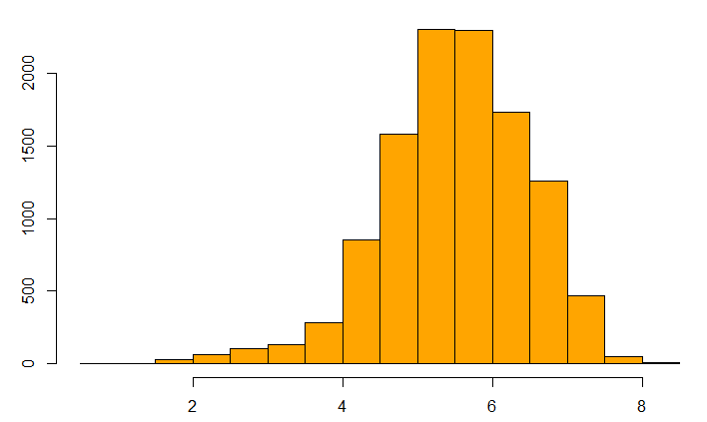
Feature Engineering & Preprocessing
Duration Raw
Log
Binning variables (age, time of the month)
Converting factors to numeric
Grouping dates for seasonality
Logs (balance, duration, campaign, previous, pdays)
K-means and -medoids clusters
Normalize dataset
80% Train 20% test
10-fold cross validation
*Balanced classification
Duration Log Transformation

Slide 5
Comparison to prior work
Moro et al. (2011) got 81% accuracy. We got 86% with ensemble techniques.
But they used duration of the call as a predictor, which we don't know before we make the call!
Dropping duration lowers accuracy – but it's an actionable model. Still 74% accuracy (no information rate is 53%).

Slide 6
Segmentation
Both classic clustering on numerical variables with k-means and more sophisticated k-medoids on all variables suggested 2 clusters (segments) best fit. PCA largely agrees.
Broadly, there's a yes-cluster and a no-cluster. Predicting within each cluster doesn't significantly improve accuracy.

Slide 7
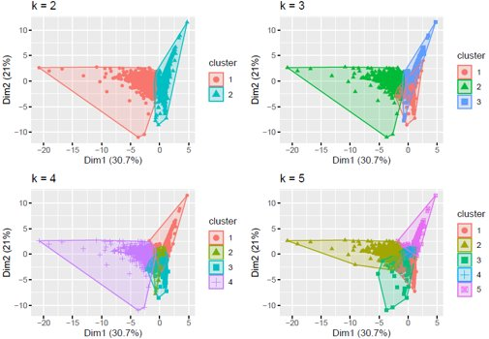
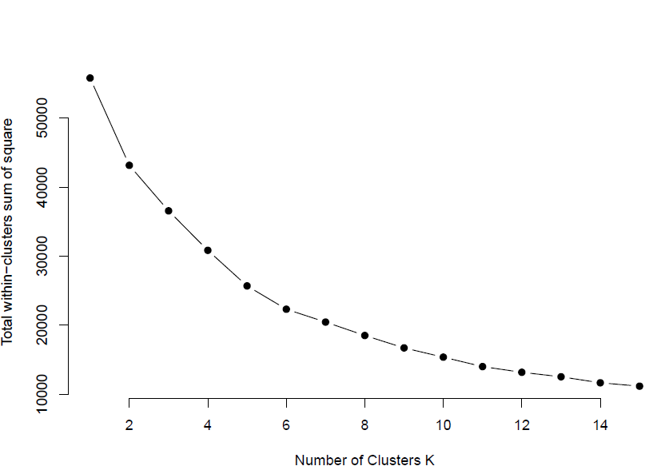
Clustering Details
Will Have Greater Success with Cluster 2
Cluster 1 Profile:
More like to make a deposit in the Spring/Summer
Less likely to have been reached by a known calling platform
Less likely to have made a deposit
More likely to have an unknown prior marketing campaign outcome
Less likely to be a student or retired

Slide 8
Algorithms used during modeling
Logistic regression (81%)
Random Forest (85%)
SVM (83%)
GBM (84%)
XgbTree (85%)
Neural Network (84%)
Lasso, Ridge, Elastic Net (81%)
Ensemble (86%)

Slide 9
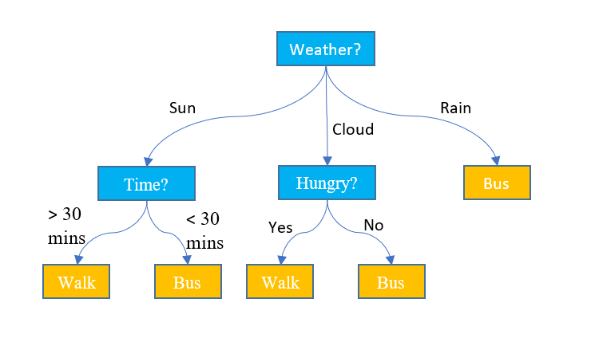
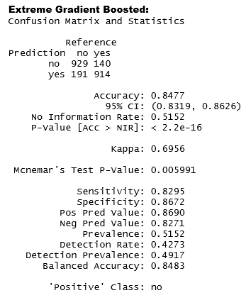
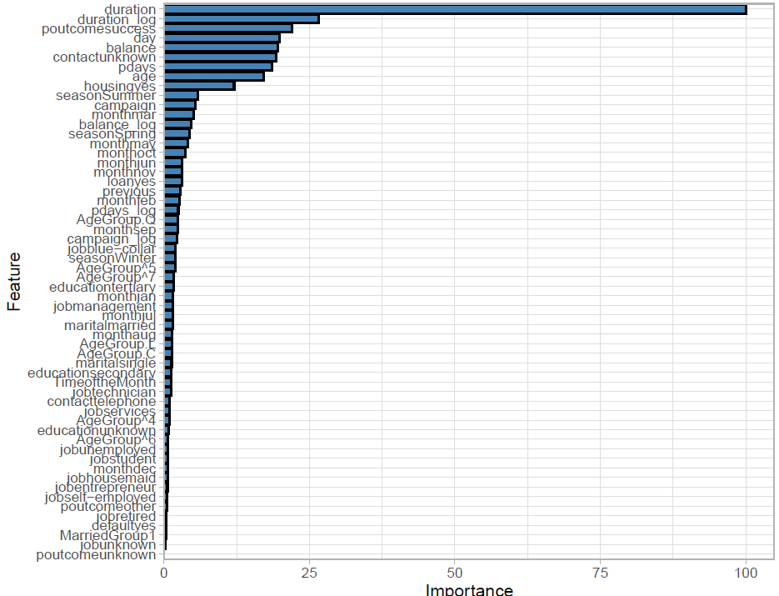
Data results: Models w/ Duration
duration: positive
poutcome_success: positive
day: negative
balance: positive
poutcome_unknown: negative
pdays: positive
age: positive
housingyes: negative
seasonSummer: negative
campaign: negative
monthmar: positive
seasonspring: negative
monthmay: negative
monthoct: positive
monthjun: negative
loanyes: negative
previous: positive

Slide 10
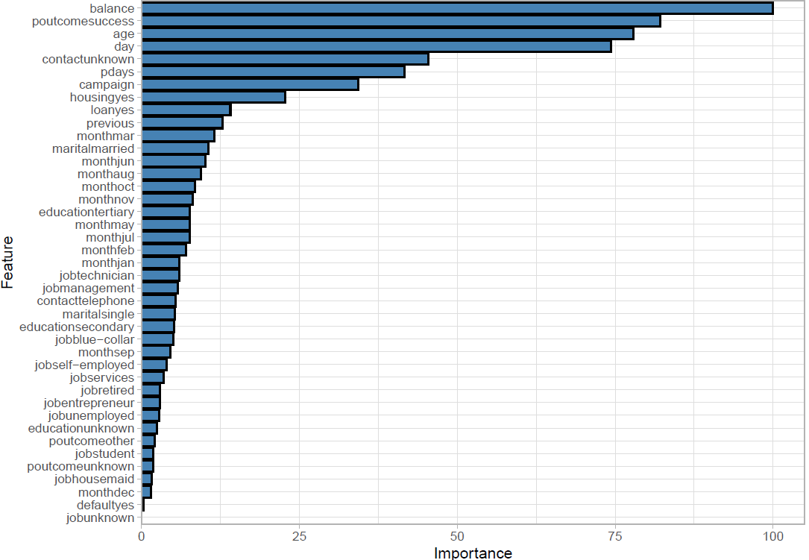
Data results: Models w/out Duration
Xgbtree
Confusion Matrix and Statistics
Reference
Prediction no yes
no 931 372
yes 189 682
Accuracy : 0.742
95% CI : (0.723, 0.7602)
No Information Rate : 0.5152
P-Value [Acc > NIR] : < 2.2e-16
Kappa : 0.4808
Mcnemar's Test P-Value : 1.541e-14
Sensitivity : 0.8313
Specificity : 0.6471
Pos Pred Value : 0.7145
Neg Pred Value : 0.7830
Prevalence : 0.5152
Detection Rate : 0.4282
Detection Prevalence : 0.5994
Balanced Accuracy : 0.7392
'Positive' Class : no
balance: positive
poutcome_success: positive
age: positive
day: negative
poutcome_unknown: negative
pdays: positive
housingyes: negative
seasonSummer: negative
campaign: negative
monthmar: positive
seasonspring: negative
monthmay: negative
monthoct: positive
monthjun: negative
loanyes: negative
previous: positive

Slide 11
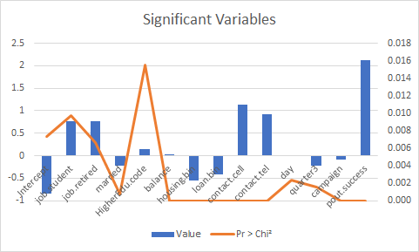
Data results: Logistic Regression
Source | Value | Standard error | Wald Chi-Square | Pr > Chi²
Intercept | -0.849577 | 0.317 | 7.195 | 0.007
job.student | 0.766 | 0.296 | 6.691 | 0.010
job.retired | 0.757 | 0.279 | 7.366 | 0.007
married | -0.227 | 0.068 | 11.237 | 0.001
HigherEdu.code | 0.152 | 0.063 | 5.854 | 0.016
balance | 0.000 | 0.000 | 23.718 | < 0.0001
housing.bin | -0.556 | 0.047 | 140.328 | < 0.0001
loan.bin | -0.420 | 0.064 | 42.669 | < 0.0001
contact.cell | 1.135 | 0.066 | 294.088 | < 0.0001
contact.tel | 0.913 | 0.102 | 79.670 | < 0.0001
day | -0.008 | 0.003 | 9.236 | 0.002
quarter3 | -0.225 | 0.071 | 9.983 | 0.002
campaign | -0.078 | 0.010 | 61.666 | < 0.0001
pout.success | 2.131 | 0.116 | 338.428 | < 0.0001

Slide 12
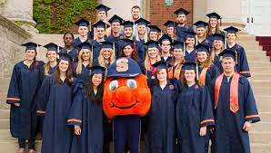

What did we learn?
Logistic Regression vs. Other types of modeling
Predictive accuracy vs. Interpretation
Repeat customers
Success in prior campaign
Cheaper to retain than to target (CLV)
Students and retirees as target populations
CLV for students
Largest balance carried by retirees
Mortgage/loan holders
Previous campaigns not successful
Capital payments
Single & Educated
Disposable income
Telemarketing was effective
Cellphone more impactful than home phone (although both significant)
Seasonal effects
Spring & Summer less desirable
Fall time to target
1
FRED Economic Data. "Assets: Liquidity and Credit Facilities: Loans: Seasonal Credit: Week Average." Accessed Feb. 12, 2021.

Slide 13
Recommendations for Marketing
Narrow campaign focus to target three specific customer segments:
Students, retirees and mortgage holders
Flagship checking account by encouraging higher balances in existing checking accounts
Waive monthly account fees if carry higher monthly average balance, direct deposit a certain amount each month or open other products (i.e. credit card, additional accounts, etc.)
Tailor campaign call script by customer segments
Students – Convenience with branch, ATM, mobile and online access
Retirees – Responsiveness with in-person service at branch locations
Mortgage holders - Focus on self-service tools, such as household budgeting; convenience of bundling products at one bank and paying mortgage with primary account
Engage product managers to consider new product development for students and retirees:
Students – Low initial balance but high potential CLV
Retirees – Larger balances, lower potential CLV
AB test of products through campaigns between similar college campuses and retirement communities (across geographic locations)
Notes:
Students and Retirees have a higher probability of saying yes. One interesting nugget would be to build product offerings around this target market.

Slide 14

Questions???

